Slide 1


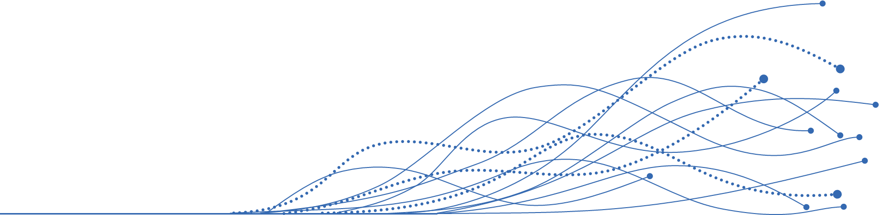


AGENTIC
Agentic AI in: Life Sciences
Designing and Building Agentic AI Teams for Life Sciences Demo: Automated Identification, Synthesis, & Reporting of Medical Insights
Q4 – 2025
Acquis Consulting. Private & Confidential

Slide 2


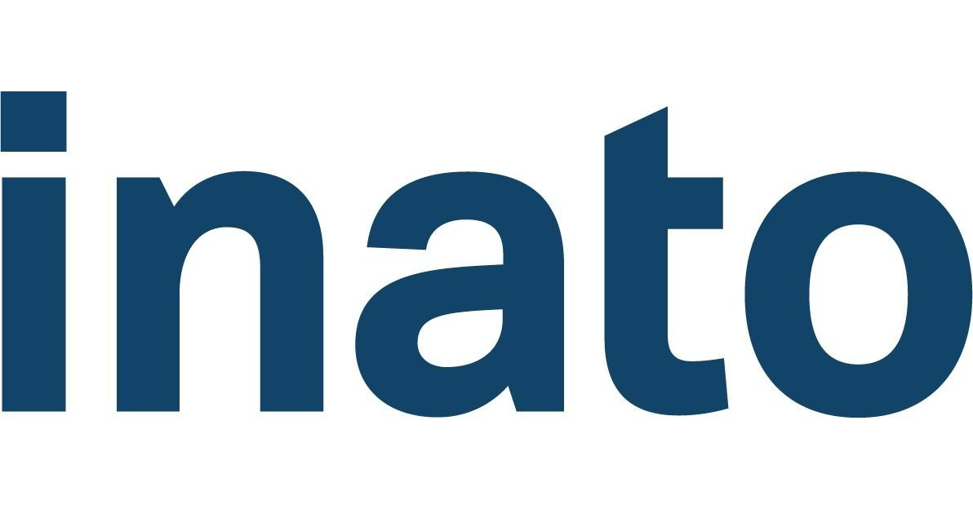
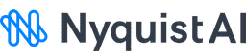



ACQUIS IS DIFFERENT KIND OF CONSULTANCY THAT BRIDGES MULTI-DOMAIN EXPERTISE TO BUILD AI-READY LIFE SCIENCE ORGANIZATIONS
Deep therapeutic expertise across R&D, Medical, and Commercial functions – we understand the science, the patients, and the business drivers behind every decision.
Decades of proven success in shaping life science organizations, aligning strategy with execution, and building scalable operating models in complex operating environments.
1.5K+
9 of 10
30+
25+
#8
175
Engagements across R&D, Medical, and Commercial Functions
Biopharmaceutical companies trust Acquis Consulting
Product launches supported
Year history (est. 1998)
Fortune’s best workplaces in consulting
Experienced Acquis consultants
LIFE SCIENCE EXPERTISE ACROSS R&D x MEDICAL x COMMERCIAL
Extensive Experience Across 10+ Therapeutic Areas
BUSINESS ACUMEN IN BUILDING OPERATING MODELS, FUNCTIONS & COMPANIES
Discover Current State Op Model
Cross-Section & Review Functions
Assess AI & Automation ROI
Build Future State
Operating Model
Oncology
Rare Diseases
Cardiovascular
Dermatology
Endocrinology
Hematology
Immunology
Neurology
Respiratory
Infectious Diseases
AGENTIC
PYRAMID
Select LS-specific AI tech stack and data provider ecosystem
TECHNICAL CAPABILITIES TO BUILD AND INTEGRATE TOOLS, AUTOMATIONS, AND AI SOLUTIONS
We build future proof functions through high ROI automations and agentic workflows
Design, build, and integrate technology solutions + agentic AI workflows that don’t just streamline tasks, but work as dynamic teammates automating core activities inside core LS functions
AGENTIC

Slide 3
Aligning on possible discussion topics today
The maturity curve of agentic AI teams in biopharma today
The art of the possible of agentic AI teams in Life Sciences (Demo)
Discuss possible agentic AI use-cases for your team?
About Acquis
Discuss other topics of interest
AGENTIC

Slide 4
The maturity curve of Agentic AI teams in Life Sciences
Where we are today vs. the future of agentic AI teams
Automated
Autonomous
Deterministic & Directive
Where we are today
Cutting edge
Self-organizing & Collaborative
Programmed Workflow Automation | Orchestrated Agentic Teams | Adaptive Agentic “Swarms” | Goal Oriented Agentic Teams
Description: Deterministic, rule-based, programmed automations that are task oriented Value: Cost savings, speed, reduced human error Status: Validated and widely deployed | Description: Centrally orchestrated agents that combine reasoning (LLMs + RAG) w/ task execution Value: Insight acceleration, higher ROI on data assets, reduced manual effort Status: Pilots underway at many pharma / biopharma companies | Description: Agents negotiate, debate, reach consensus, adapting roles dynamically Value: Flexibility, scalability, robustness against workload changes Status: Experimental in other industries – likely sandbox pilots in pharma in 3–5 years due to regulatory trust barriers | Description: Goal-oriented, self-organizing agent teams collaborating without central human orchestration Value: Adaptive artificial intelligence at an organizational scale Status: Purely visionary and on the bleeding edge of AI research today
AGENTIC

Slide 5
The art of the possible of Agentic AI teams in Life Sciences
What we will cover in today’s demo on Medical Insights
Raw Input Data Processes
Orchestrated Agentic Teams
Automated Outcomes
Documentation Reader Agent(s)
Automated Initiation Triggers
Input to Idea Parser Agent
Idea to Insight Evaluator Agent
Insight Categorization Agent
Insight Analysis Agent
Automated .pptx Generator
CRM CSV Upload
This agent reads raw data input from centralized (CRM) database to separate distinct ideas out of a single input
This agent evaluates the value of each distinct idea, and whether they qualify as a useful medical insight
This agent tags every insight by pre-set (and customizable) categories that are relevant to the organization’s strategic medical imperatives, for ex:
Market access insights
Competitive intelligence
Clinical practice insights
HCP education gaps
Clin dev insights
This agent counts, correlates tagged insights with original data entry IDs, and analyzes relevant data across themes
API to CRM
Safety & AE Alerting Agent
Automated AE Notification Triggers
Some insights may be flagged as a possible AE based on regulatory and company specific definitions; which can trigger an automated AE notification to interested parties
Agentic AI Model*
Programmed Automation
Human Action
AGENTIC
*All agents use Claude Sonnet 4 model as underlying LLM

Slide 6
Deep-dive into three agents that can read raw input, evaluate ideas, and categorize insights
Input-to-Idea Parser Agent
Caught Dr. Swift Taylor at ESMO during a coffee break. She shared that she is seeing more HCPs going back to glofitamab (vs. epcoritamab) because of bad experiences with the step-up dosing schedule, which she admits is confusing at times and could be clearer. At the end of chat, she offhanded asked if we’ve seen a lot of patients gain muscle mass while on epco. She had a patient gain 20lbs of pure muscle mass with no other lifestyle changes.
Raw Input
Caught Dr. Swift Taylor at ESMO during a coffee break
more HCPs going back to glofitamab because of bad experiences with the step-up dosing schedule
which she admits is confusing at times and could be clearer
she offhanded asked if we’ve seen a lot of patients gain muscle mass while on epco
She had a patient gain 20lbs of pure muscle mass with no other lifestyle changes.
Ideas
Idea-to-Insight Evaluator Agent
No
Yes
Yes
Yes
Yes
This idea falls under meeting logistics, which does not meet the definition of an insight
This idea mentions a competitor asset which falls under the definition of a competitive insight
This idea mentions a lack of clarity, which is an indicator of an education gap
This idea mentions a possible product insight for future development
This idea describes an unintended sign, symptom, or disease which could fit the definition of an AE
Why? Valuable?
Insight Categorization Agent
N/A
Competitive Intelligence
Education
Possible AE
N/A
The dosing regiment of Epcoritamab is a key competitive differentiator vs. other legacy drugs
The step-up schedule is described as ‘confusing at times” which may warrant efforts to fill an educational gap
The muscle gain, while a potentially positive effect, describes a patient and an unintended sign, symptom, or disease
Why? Category?
Why? AE?
AGENTIC

Slide 7
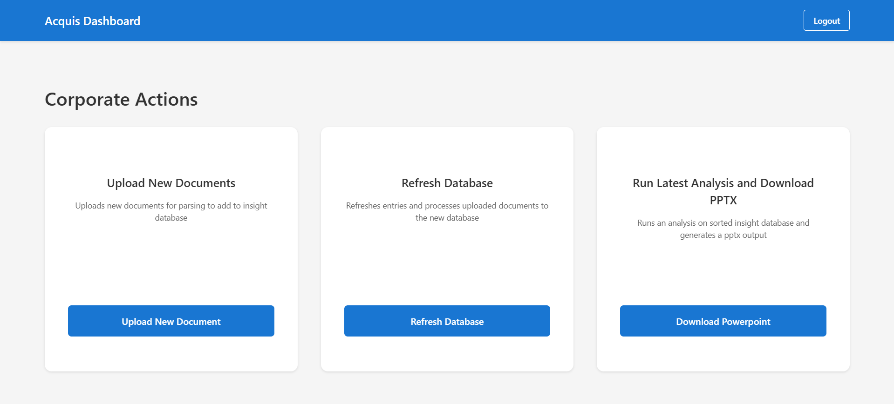
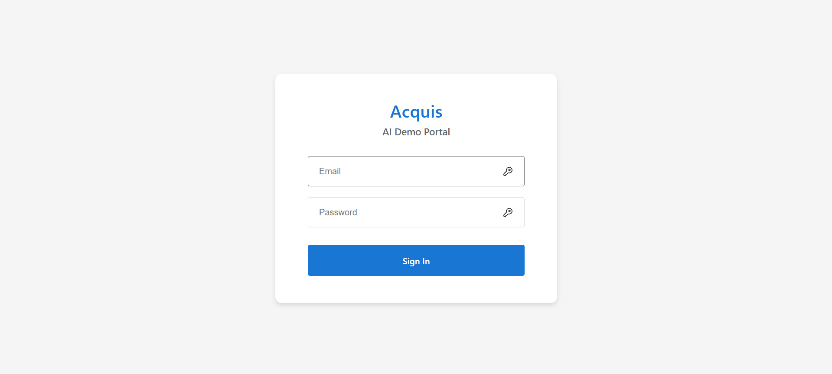
Example Front End – how human teams can interface with agentic teams
AGENTIC

Slide 8
Real Example Output – Agentic AI teams that can read raw input, evaluate ideas, and categorize insights
Input-to-Idea Parser Agent
Happened to see Bichael Muble at the Starbucks outside the congress hall. Note to self, he likes to drink matcha frappuccino with lavendar cold-foam. After catching up a bit, he mentioned that formulary reviews at their institution have been pushed back repeatedly, which is slowing adoption of new therapies. They also observed competitor reps spinning head-to-head trial data in ways that confuse less experienced staff. As we were closing the discussion, he told me a funny story about one of his bald patients experiencing rapid hair regrowth while on epco. The patient joked that that the hair made him look 20 years younger! He wanted to reconvene next quarter to hear about any new findings.
Raw Input
After catching up a bit, he mentioned that formulary reviews at their institution have been pushed back repeatedly, which is slowing adoption of new therapies.
They also observed competitor reps spinning head-to-head trial data in ways that confuse less experienced staff.
Happened to see Bichael Muble at the Starbucks outside the congress hall. Note to self, he likes to drink matcha frappuccino with lavendar cold-foam.
He wanted to reconvene next quarter to hear about any new findings.
As we were closing the discussion, he told me a funny story about one of his bald patients experiencing rapid hair regrowth while on epco. The patient joked that that the hair made him look 20 years younger!
Ideas
Idea-to-Insight Evaluator Agent
Yes
Yes
No
No
Yes
Highlights an access barrier affecting therapy adoption that could inform Medical Affairs engagement strategy.
Reveals competitive misinformation creating educational gaps among clinical staff, actionable for Medical Affairs education initiatives.
Personal beverage preferences are trivial context unrelated to medical insights.
Future meeting logistics without substantive medical or strategic content.
Describes an unexpected beneficial outcome (hair regrowth) in a patient on epcoritamab, meeting AE criteria for any unintended medical occurrence during product use.
Why? Valuable?
Insight Categorization Agent
Access Insights
Competitive Insights & Education Insights
N/A
Possible AE
This statement describes institutional formulary review delays, which is a classic access barrier affecting drug availability and adoption at the health system level.
Primary focus is on competitor promotional activity and misinformation strategies (Competitive), but also identifies educational needs for clinical staff who are being confused by this messaging (Education).
N/A
This describes an unexpected beneficial outcome (hair regrowth) in a patient on epcoritamab, which meets AE criteria for any unintended medical occurrence during product use. It also provides feedback about the company's own product (epco), making it a Product Insight as well.
Why? Category?
Why? AE?
AGENTIC

Slide 9
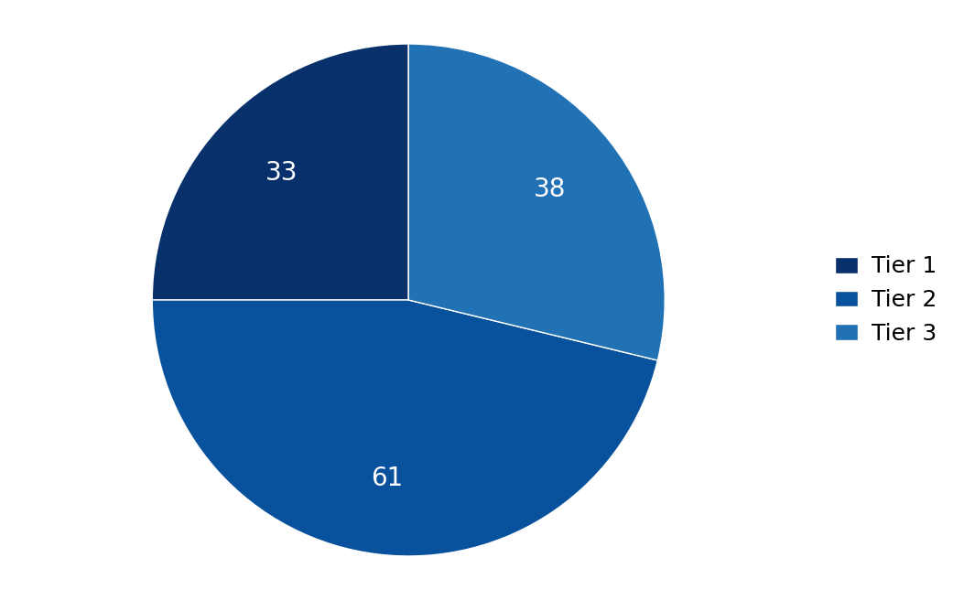
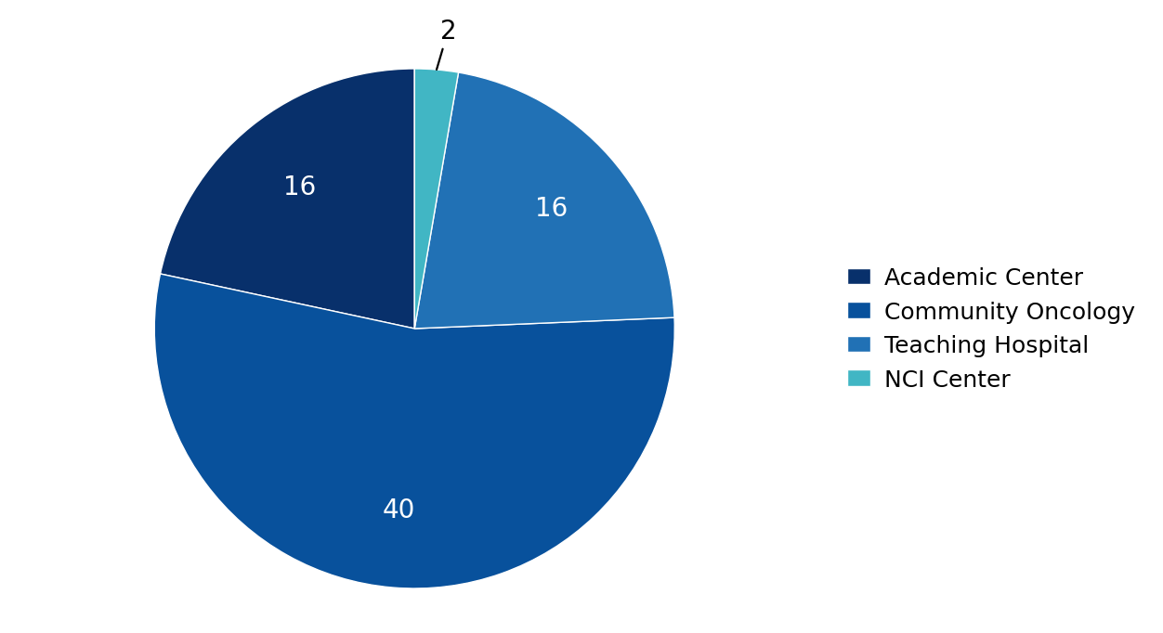
Real Example Output – Automated Executive Dashboard
INSIGHT BREAKDOWN PER INSIGHT CATEGORY
INSIGHT BREAKDOWN BY HCP PRACTICE SETTING
MEDICINE:
Epcoritamab
Epcoritamab is a bispecific antibody developed by AbbVie and Genmab for the treatment of certain B-cell malignancies such as diffuse large B-cell lymphoma (DLBCL).
Date Range of Report
June 2025 - October 2025
Total Deployed MSLs
10
Total # HCP Interactions
Total # of Insights Produced
Access Insights
Patient Management / Care Insights
Clinical Development Insights
Total: 74
132
23
39
9
Total # of Non-Insights
Competitive Insights
Product Insights (Drug Science)
Education Insights
Congresses This Quarter
132
ASCO 2025
ASH 2025
EHA 2025
ICML 2025
22
11
41
Logistics
Adverse Event (AE) Insights
Other Insights
7
14
2
AGENTIC

Slide 10
Real Example Output –
TOP THREE THEMES FROM PATIENT CARE MANAGEMENT INSIGHTS
Theme 1 (n=9)
Theme 2 (n=7)
Theme 3 (n=10)
Patients frequently miss doses or self-discontinue therapy with minimal follow-up or proactive monitoring systems.
Primary care physicians wait too long to refer patients to oncology, limiting treatment options.
Post-treatment monitoring and survivorship care lacks standardization with poor coordination between specialties.
Description
Description
Description
id 38: 'Patients frequently miss doses because they're juggling work, childcare, or school, and no one systematically follows up until problems arise.'
id 78: 'Adherence monitoring is practically nonexistent once patients leave the hospital. Staff assume patients are compliant, but in reality missed doses are common.'
id 92: 'Patients often self-discontinue once symptoms improve.'
id 59: 'Community physicians often wait until multiple treatment failures before referring to oncology, and by then options are limited.'
id 51: 'Primary care referrals often arrive too late, sometimes months after first symptoms.'
id 95: 'Primary care physicians often fail to recognize early symptoms, delaying referrals into oncology.'
id 70: 'Follow-up care is fragmented, with little communication between oncology and primary care once treatment ends.'
id 65: 'Survivorship care is handled inconsistently in their hospital, often depending on the initiative of individual providers.'
id 85: 'Variability in monitoring practices post-therapy, with no consensus across community sites.'
Supporting Quotes
Supporting Quotes
Supporting Quotes
1: What proactive adherence monitoring systems can be implemented to track patient compliance in real-time?
2: How can digital tools or caregiver engagement reduce missed doses across different age demographics?
1: What early symptom recognition tools can be provided to primary care physicians to accelerate appropriate referrals?
2: How can oncology-primary care communication pathways be strengthened to reduce referral delays?
1: What standardized survivorship care templates can ensure consistent long-term patient monitoring across institutions?
2: How can oncology-primary care handoff protocols be formalized to prevent care coordination gaps?
Considerations
Considerations
Considerations
AGENTIC

Slide 11
Real Example Output –
TOP THREE THEMES FROM COMPETITIVE INTELLIGENCE INSIGHTS
Theme 1 (n=11)
Theme 2 (n=8)
Theme 3 (n=6)
Trainees consistently misinterpret trial endpoints, subgroup analyses, hazard ratios, and Kaplan-Meier curves, leading to confusion in practice application.
Healthcare providers lack confidence in making dose adjustments, especially in frail patients, and need simplified management tools for complex cases.
Competitor companies are heavily investing in educational programming and promotional activities that are shaping physician perceptions and prescribing patterns.
Description
Description
Description
id 37: 'They explained that fellows in their program often misinterpret subgroup analyses in trial readouts.'
id 50: 'They commented that fellows are still struggling to understand endpoints like PFS versus OS.'
id 63: 'They shared that residents and fellows are still struggling to interpret trial data, particularly hazard ratios and subgroup analyses.'
id 41: 'They said residents are confused about dose modifications in frail patients.'
id 69: 'They said younger physicians often hesitate to make dose adjustments in complex patients, preferring to refer cases to senior colleagues.'
id 86: 'Lastly, they observed that their junior colleagues still struggle with dose modifications in frail patients, suggesting more training modules are needed.'
id 43: 'They said rival teams are 'outspending everyone else' with sponsored dinners, symposia, and starter kits.'
id 64: 'They've noticed rival companies are offering well-attended dinners and providing attractive starter kits to clinics.'
id 52: 'They explained that competitor reps are heavily emphasizing safety profiles, sometimes overstating the data.'
Supporting Quotes
Supporting Quotes
Supporting Quotes
1: What specific interactive teaching methods would most effectively help trainees distinguish between exploratory and practice-changing trial data?
2: How can complex statistical concepts like hazard ratios and subgroup analyses be simplified for practical clinical application?
1: What specific patient characteristics or clinical scenarios create the most uncertainty in dose modification decisions?
2: How can simple reference tools be designed to build provider confidence without oversimplifying complex clinical decisions?
1: What specific competitor messaging or educational tactics are most effectively influencing physician decision-making?
2: How can scientific programming be designed to counter competitor narratives while maintaining evidence-based credibility?
Considerations
Considerations
Considerations
AGENTIC

Slide 12
Real Example Output –
TOP THREE THEMES FROM HCP EDUCATION INSIGHTS
Theme 1 (n=8)
Theme 2 (n=8)
Theme 3 (n=5)
Competitors are dominating local engagement through frequent visits, sponsored events, and promotional activities, overshadowing our presence.
Competitors are selectively presenting or overstating clinical data, creating false impressions of superiority that mislead healthcare providers.
Competitors are successfully positioning their products as more convenient and easier to use, gaining traction with healthcare providers.
Description
Description
Description
id 43: 'rival teams are "outspending everyone else" with sponsored dinners, symposia, and starter kits'
id 64: 'rival companies are offering well-attended dinners and providing attractive starter kits to clinics'
id 82: 'competitor reps have been visiting their institution more frequently than ours, offering multiple sponsored dinners'
id 39: 'competitor reps are presenting safety data selectively, creating the impression of superiority'
id 52: 'competitor reps are heavily emphasizing safety profiles, sometimes overstating the data'
id 79: 'competitor's local reps are aggressively promoting their survival data, sometimes overstating results'
id 46: 'competitor's "ease of use" messaging is resonating with nurses'
id 57: 'some of their patients are switching to competitor therapy after hearing claims of reduced monitoring needs'
id 73: 'competitor teams are positioning their new formulation as much easier to use and this messaging is gaining traction'
Supporting Quotes
Supporting Quotes
Supporting Quotes
1: What specific engagement strategies can we implement to match or exceed competitor visibility in key regions?
2: How can we better leverage educational programming and starter programs to compete with aggressive outreach?
1: How can we provide balanced, comprehensive data education to counter selective messaging?
2: What mechanisms can help less experienced providers better evaluate competing clinical claims?
1: What specific convenience advantages can we highlight or develop to compete with ease-of-use messaging?
2: How can we address perceived complexity barriers while maintaining appropriate safety protocols?
Considerations
Considerations
Considerations
AGENTIC

Slide 13
AGENTIC
Questions?
Designing and Building Agentic AI Teams for Life Sciences Demo: Automated Identification, Synthesis, & Reporting of Medical Insights
Q4 – 2025
Acquis Consulting. Private & Confidential

